Slide 1


Unique Resolution Standard Kit Fabricated by Proton Beam -Facilitates Accurate & Fast Beam Size Measurements
Prof Jeroen van Kan

Slide 2
Background Inventor
Prof Jeroen van Kan
Director of Centre for Ion Beam Applications a collaborative Center to the IAEA
Vice President of the Microscopy Society Singapore
Deputy Director for the Engineering Science Programme, NUS
Member of the editorial board of Microelectronic Engineering
Department of Physics
National University of Singapore (NUS)
E-mail: Phyjavk@nus.edu.sg
2

Slide 3
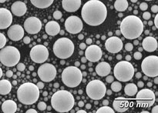
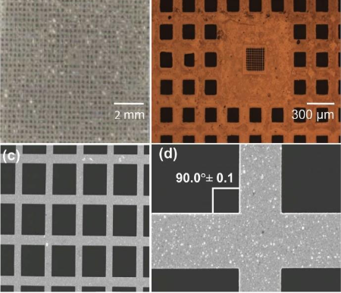
Resolution Standard Kit
Overview
Used for calibrating and characterising spatial resolution and scan dimensions of imaging systems
Requirements for charged-particles imaging include high spatial resolution, precise beam spot size measurement with low uncertainty
Two kinds of resolution standards:
Spherical with sizes ranging from a few nm to hundreds of nm
Grid with periodic patterns
Commercial spherical tin balls [1]
Nickel grids [2]
[1] https://www.tedpella.com/calibration_html/SEM_Resolution_Test_Specimens_Tin_on_Carbon.aspx
[2] Y. Yao et al. Improved beam spot measurements in the 2nd generation proton beam writing system (2013)
3

Slide 4

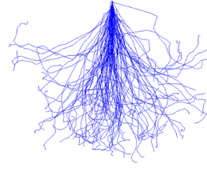

Interactions of MeV Light Ions With Matter
Resolution Determination Methods
Edge Scanning scans edges of features, resulting line profile fitted using mathematical function to determine resolution [3]
Spherical RS relies on curvature at the side; Grids with straight side-walls may perform better, eliminating error introduced by curvature of sphere
Gap Scanning scans gaps between adjacent features [4]
No fixed gap sizes for spherical RS, best resolution depends on smallest gap available; Edge Scanning with Grids only utilises side-wall straightness, eliminating physical limits of gaps
Advantages of Our Standards
2 MeV
Protons
50 keV
Heavy Ions
50 keV
Electrons
60 µm
Different particles interacting with medium [5]
CIBA’s Proton Beam Writing (PBW) able to produce grids with straight side walls [5]
Side wall angle ~89.9°, much better than industry standard of ~88.5° [1]
Sidewall angle
[3] J. Swindells et al. Modelling PSF of scanning electron microscopes for image restoration (1998)
[4] V. András et al. On the Sub-Nanometer Resolution of Scanning Electron and Helium Ion Microscopes (2009)
[5] F. Watt et al. Proton beam writing (2007)
4

Slide 5
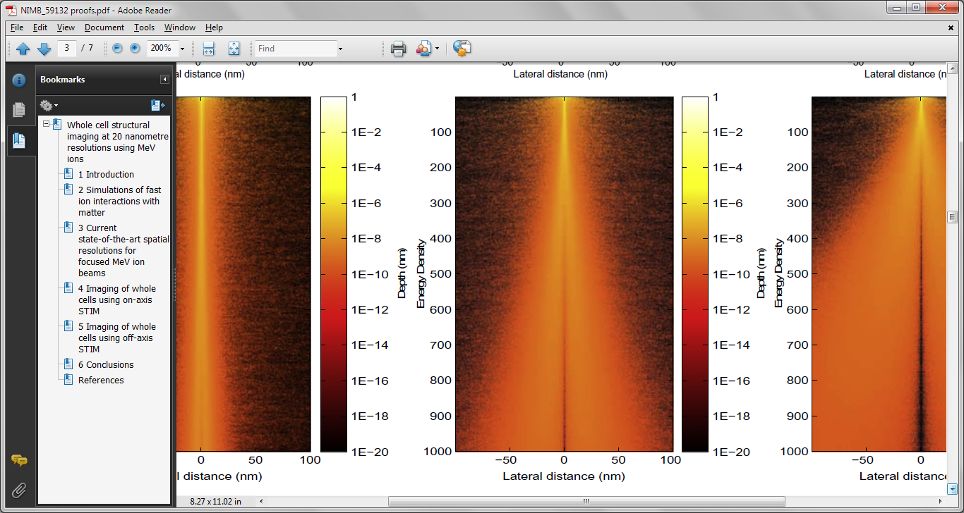
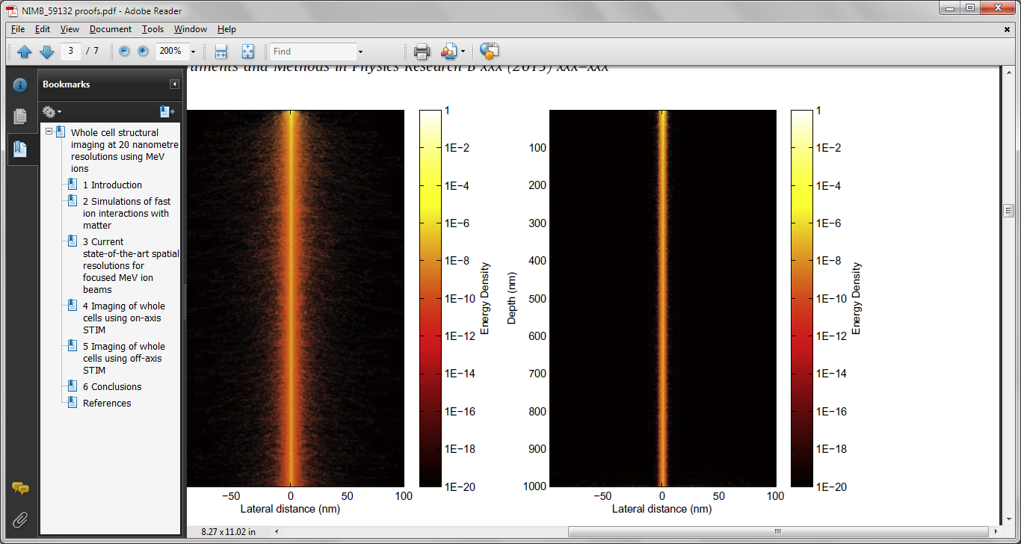
Energy Deposition in 1 µm PMMA (Delta Rays)
E-Beam ↔ P-Beam
Electron Beam & Proton Beam Induced Delta Rays or Secondary Electrons
Spatial Energy
Deposition Profile
using DEEP code
Depth (nm)
P-beam writing is potentially superior compared to E-beam!
100 keV Electrons
500 keV Protons
Reduced Proximity Effects ➔ High Density & Fine Structures (Analysis & Lithography)
Depth can be tuned ➔ High aspect ratio, Multi Level structures & 3D Analysis
Straight trajectory ➔ Smooth Side Walls & Well resolved features
High sensitivity – 100 fold higher than electrons (Single Ion Imaging)
Udalagama et al. PRB (2009)
5

Slide 6
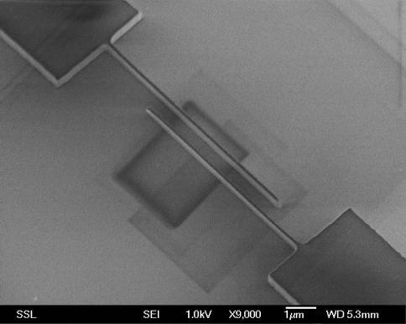
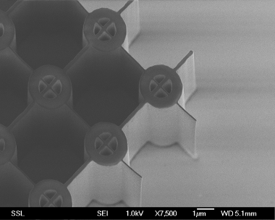
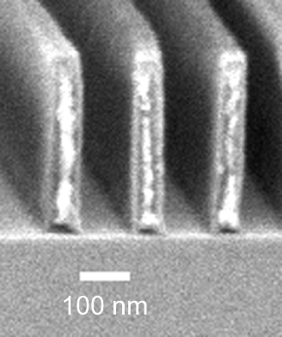
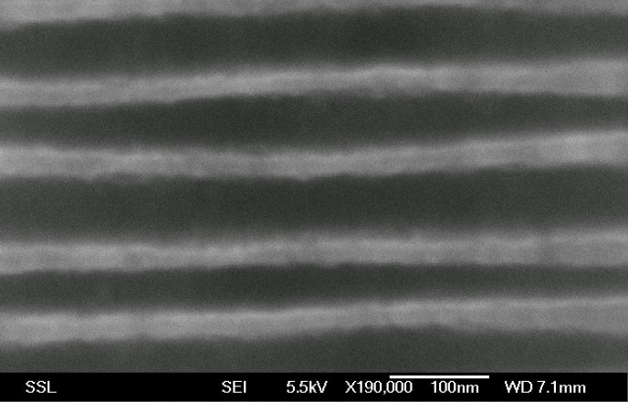
PBW: High Aspect Ratios in Resist
PMMA Requires 3.5 eV bond breaking
HSQ requires 4 & 8 eV cross linking
These electron are used for imaging
Proton Beam Writing of Three-Dimensional Nanostructures in HSQ
J.A. van Kan, et al
Nano Letters 6 (2006) 579
10 μm
Thick SU-8
50 nm lines in PMMA
100 nm thick HSQ
60 nm
19 nm
Three-dimensional nanolithography using proton beam writing
J.A. van Kan, et al Appl. Phys. Lett., 83 (2003) 1629
Microsyst Technol, 2014
2014
6

Slide 7
Proton Imaging: IBAC & STIM
IBAC
STIM
Ni Grid 1 µm thick
IBAC (Ion Beam Absorbed Current)
STIM (Scanning Transmission Ion Microscopy)
35 x 101 nm @ (1.5 MeV H₂⁺ 1 pA)
X - 35 nm
Y - 101 nm
7

Slide 8
Proton Imaging: STIM & Electron Detection
On Axis STIM
Off-axis STIM
Ni Grid 1 µm thick
On/Off Axis STIM (Scanning Transmission Ion Microscopy)
Proton Induced Electron Imaging
15 x 36 nm @ (2 MeV H₂⁺ ~ fA)
Electron Detection
Beam Size: X - 15 nm
Y - 36 nm
8

Slide 9
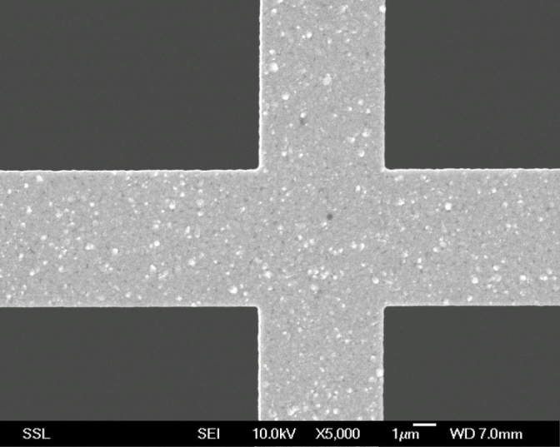
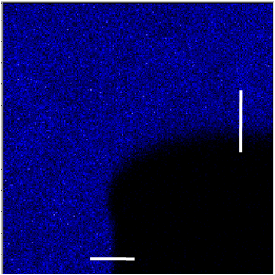
Proton Microscopy at Sub-10 nm
Sub 10 nm resolution
Ni Grid
1 µm thick
STIM imaging of Ni grid
Detector
IBIC (Ion Beam Induced Current) protons travel through 1 um on Ni before reaching PN junction
1 µm
Ni grid
Counts
E
Si PN junction
Ultra Microscopy 2023
9

Slide 10
Result Was Proven
Our technology was published by many established scientific journals [1-3]
Proven Record
We have been using the same grid for more than 10 years without degrading performance in CIBA PBW system for setting up all kinds of Proton Microscopy experiments for us & customers
Commercial Usage-Customers Validation
Some customers have bought our kits
Gave positive feedback that our kits have more superior function than others . Which enables them to have better performance
[1] J. A. van Kan et al. Fabrication of a free standing resolution standard for focusing MeV ion beams to sub 30 nm dimensions (2005)
[2] Y. Yao et al. Improved beam spot measurements in the 2nd generation proton beam writing system (2013)
[3] S. Qureshi et al. Automated alignment and focusing system for nuclear microprobes (2019)
[4] Y. X. Dou et al. Breaking the 10nm barrier using molecular ions in nuclear microprobes (2023)
10

Slide 11
Conclusions:
Resolution Standard Kit via Proton Beam
Potential
Consistent production of Resolution Standard Kit with proven high resolution capability
Tried-and-tested SOP for production
Proven track record of consistent small beam spot sizes with heavy usage over a decade
Commercially available
11

Slide 12

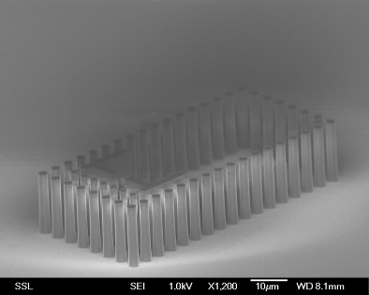
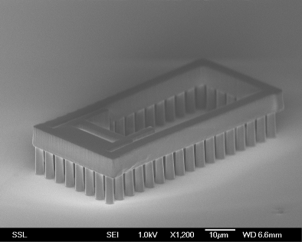
Thank You
Support from:
NRF, MOE, NUS (Singapore),
US air force
12

Slide 16
Proton Microscopy at Sub-10 nm
Historic beam spot size improvement
Normally, a nuclear microprobe has a different resolution in two lateral directions (i.e. rectangular profile).
Here, the definition of resolution is the square root of the product of resolutions in X & Y axes.
CIBA has been at the forefront of resolution improvements with MeV proton beams for most of the 21st century!
*Reported 1-D resolution
Dou, Y. et al. Breaking the 10 nm barrier using molecular ions in nuclear microprobes Ultramicroscopy 253, 113812 (2023)
16

Slide 17
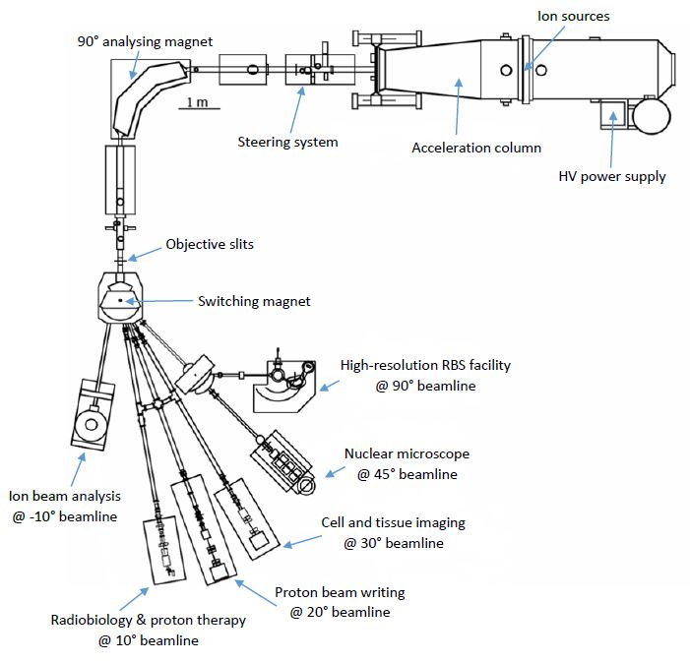
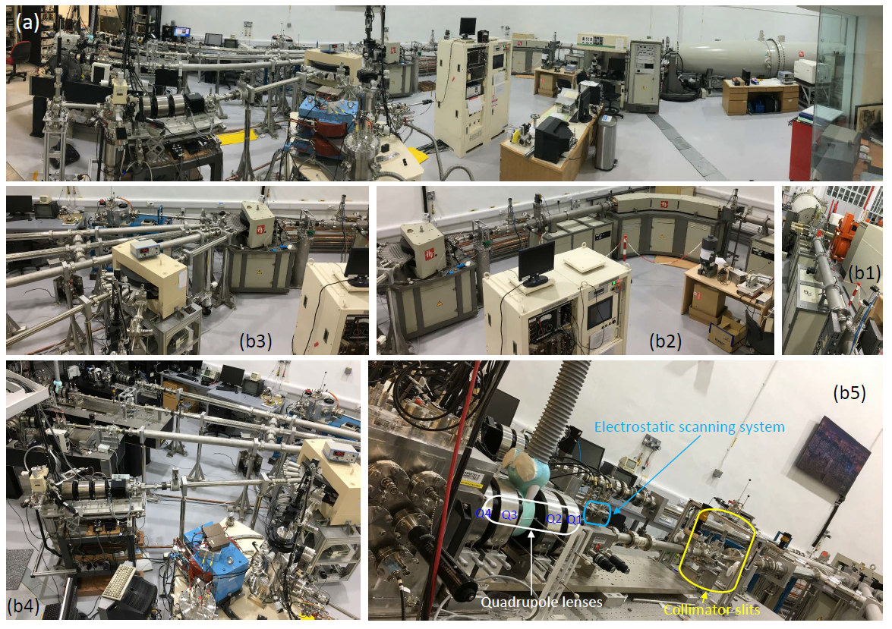
CIBA Ion Beam Facility
17

Slide 18
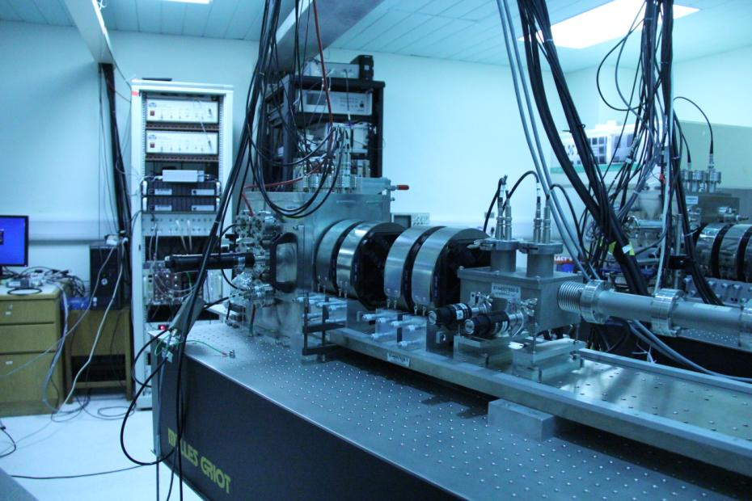
Proton Beam Writing Line
Multi disciplinary research utilising high energy light ion beams
Silicon
Nano-replication
micromachining
Tissue-engineering
Biophysics
Micro/Nano
fluidics
IC Failure
Analysis
Nano
engineering
Microphotonics
Materials
characterisation
18

Slide 19
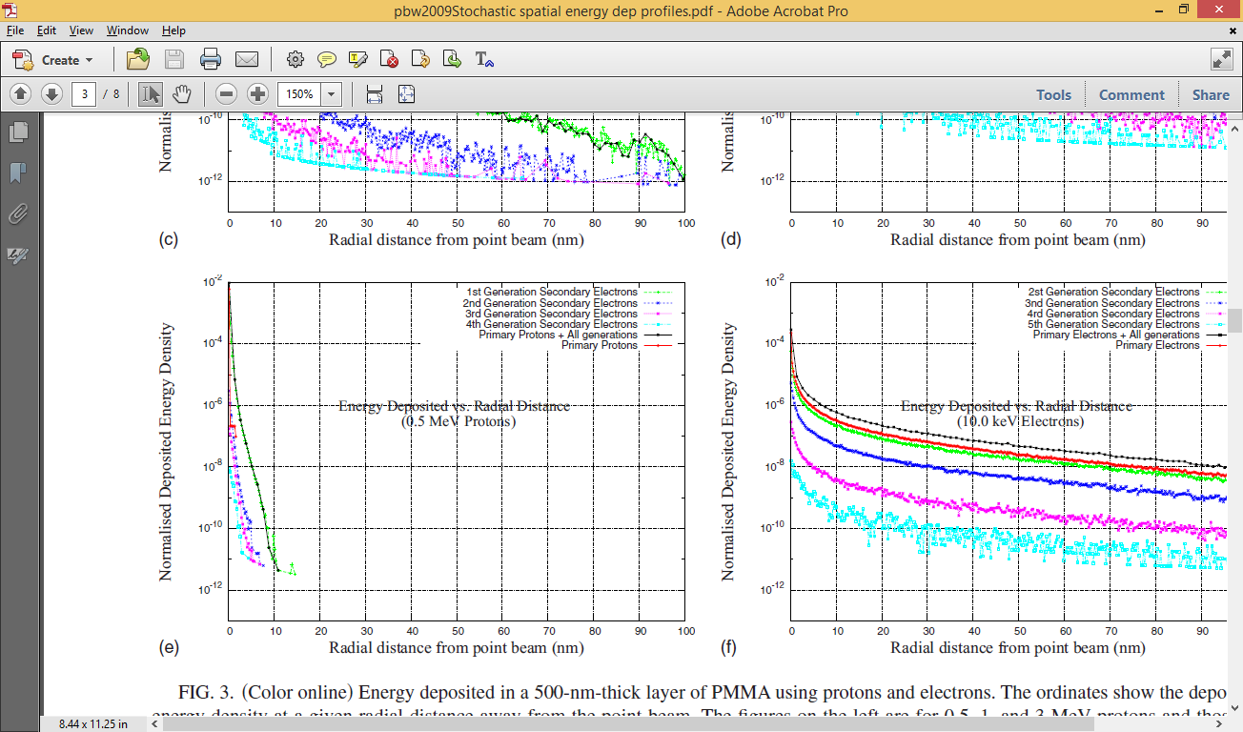
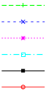
Proton Interaction With Material at Nano Scale
500 keV Protons
100 keV Electrons
1 nm
2 nm
1000 nm
Normalized Deposited Energy
1st Gen-e
2nd Gen-e
3rd Gen-e
4th Gen-e
All (e + P)
Primary P
Radial Distance (nm)
PRB (2009)
19
Notes:
19

Slide 20
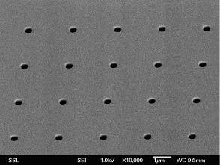
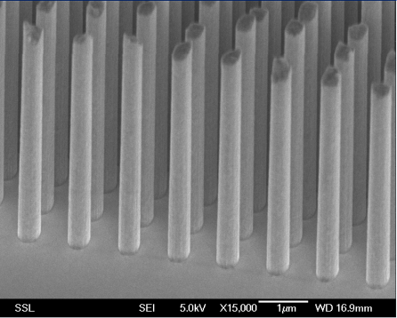
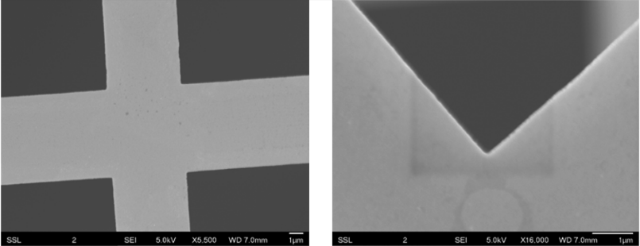
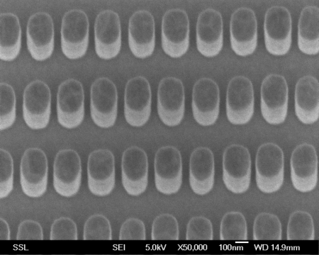
Proton Beam Writing
Neg or Positive Resist
Proton beam
exposure
Ni
Seed layer
Crosslink
Negative resist
Chain scission
Positive resist
Chemical
development
Insoluble for
developer
Remove
exposed resist
PMMA mold for plating
Ni
Electroplating
Au
H: 5 μm
700 nm
Strip
SU-8 or PMMA
SEM image of grid showing orthogonality (left) and smoothness (right) of grid bars [3]
35 nm
Res Kit
Ni structure
20
Notes:
20

